Slide 1
FULL STACK DEVELOPMENT COURSE
DAY 03
IRFANSJAH
irfansjah@gmail.com
081293728732

Slide 2
BASIC PROGRAMMING CONCEPT
VARIABLES, DATA, DATA TYPE and OPERATORS
STATEMENT, STATEMENT BLOCK and NESTING
What is Data and DataType ?
How the data represented in a Computer System
Data Classification : Data Types
From Human Readable Data into Computer Binary Data
Common Known Data Type
Characters,
Numbers
Binary
Series, Collections
What is Variables ?
Definitions
Basic Rules of variables in Computer System
Values and References
Data Operations and Operators
Type of Operators
Assignment
Mathematical Operation
Logical Operation
Unary Operation
Binary Operation
Series
PROGRAMMING CONCEPT

Slide 3
BASIC PROGRAMMING CONCEPT
VARIABLES, DATA, DATA TYPE and OPERATORS
STATEMENT, STATEMENT BLOCK and NESTING
SENTENCES
Statement and its separators
Statement Block
Nested Block
Comments
Common Sentences Structures
Statement : Variable Definitions
Statement : Command Block
Command Block Type :
data operation
function call
PROGRAMMING CONCEPT

Slide 4
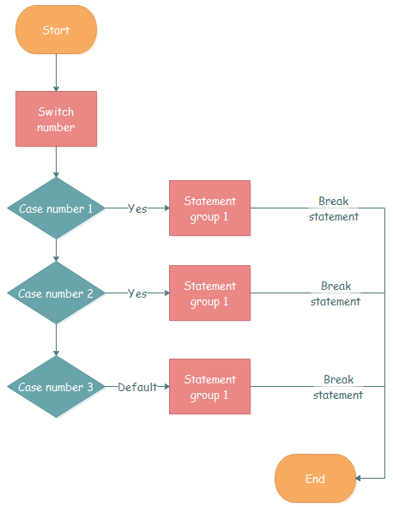
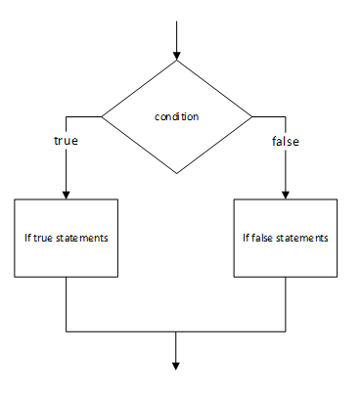
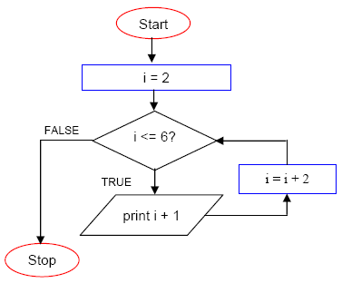
BASIC PROGRAMMING CONCEPT
CONTROL STRUCTURES
BRANCHING
IF Statement
SWITCH Statement
LOOPS
FOR
Logical Loops : While, Until
Collection Loops
PROGRAMMING CONCEPT

Slide 5
BASIC PROGRAMMING CONCEPT
FUNCTION / METHOD
Function / Method
What is Function
Why we need Function / Method
Function structures
Basic Function Definitions
Named Function and Anonymous Function Definitions / Lambda / Expression
Function Parameters / Arguments
Return Values
Working with Libraries
What are libraries
Scope and Namespace
Function as a Data Type
PROGRAMMING CONCEPT

Slide 6
BASIC PROGRAMMING CONCEPT
ADVANCE DATA TYPE
ARRAY, COLLECTIONS
STRUCTURE / RECORD
FUNCTION / DELEGATE
OBJECT
INTERFACE
PROGRAMMING CONCEPT

Slide 7
BASIC PROGRAMMING CONCEPT
OBJECT ORIENTED PROGRAMMING
What is OBJECT
What is Object
Object Components
Field
Method / Function
Property
Events
INHERITANCE vs INSTANCING
METHOD OVERLOADING AND OVERRIDING
ABSTRACT, SEALED, STATIC
EXTENDING OBJECT
PROGRAMMING CONCEPT

Slide 8
BASIC PROGRAMMING CONCEPT
VARIABLES, DATA, DATA TYPE and OPERATORS
STATEMENT, STATEMENT BLOCK and NESTING
1. VARIABLES, DATA, DATATYPES and OPERATORS 2. STATEMENT and BLOCK STATEMENT and NESTING 3. SCOPE and CODE STRUCTURE 4. CONTROL STRUCTURES : LOGICAL BRANCHING (IF, SWITCH), LOOPS (FOR, FOREACH, WHILE) 5. FUNCTION / METHOD and PARAMETERS, BY REFERENCE and BY VAL, between return VOID and return VALUE 6. COMPLEX DATA TYPES : ARRAY and STRUCTURE 7. ADVANCE COMPLEX DATA TYPE : OBJECT and INTERFACE 8. OBJECT ORIENTED PROGRAMMING 9. ERROR HANDLING
PROGRAMMING CONCEPT

